Slide 1

Demonstration 7PAM2002-0509-Data Science Project 10-06-2026
University of Hertfordshire
School of Physics, Engineering and Computer Science
Smart Energy Consumption Forecasting and Anomaly Detection Using Time-Series Machine Learning Models
Name: Mohan Marthala
Student Id: 24068622
Supervisor: Vid Irsic
https://github.com/Marthalamohan/MSC_PROJECT.git

Slide 2
Introduction
Motivation
Household electricity consumption shows complex temporal patterns influenced by daily routines and seasonal changes.
Accurate energy forecasting can help improve energy management and efficiency.
Detecting abnormal consumption patterns is important for identifying unusual energy usage and potential system issues.
Machine learning and time-series models provide powerful tools to forecast energy consumption and detect anomalies automatically.
Research Question
How accurately can household electricity consumption be predicted using time-series models, and can machine learning methods automatically detect abnormal energy usage patterns?

Slide 3
Objectives
To develops machine learning models to forecast household electricity consumption using time-series data.
To implement three forecasting models such are RandomForest, XGBoost, and Prophet.
To evaluate the models using RMSE and MAE metrics to measure prediction accuracy.
In addition to forecasting, the project also aim to implement anomaly detection techniques to identify unusual energy consumption patterns.

Slide 4
Overview if previous work related to the project
Deep Learning for Energy Forecasting
Recent research shows that deep learning models such as LSTM and CNN can effectively forecast household electricity consumption by capturing temporal patterns in energy data (Cascone et al., 2023).
Statistical Time-Series Models
Traditional time-series methods such as ARIMA and Auto-ARIMA have been widely used to analyze historical energy consumption data and predict future electricity demand (Ahmed & Khamees, 2025).
Hybrid Machine Learning Models
Hybrid deep learning architectures combining multiple neural network layers have been proposed to improve prediction accuracy in smart building energy forecasting (Syed et al., 2021).
Time-Series Forecasting Foundations
Time-series analysis methods model trends, seasonality, and irregular components of data to support accurate forecasting in many domains including energy systems (Adhikari & Agrawal, 2013).

Slide 5
WHAT WILL YOU DO
This project develops machine learning models to forecast household electricity consumption using time-series data.
Three forecasting models are implemented: RandomForest, XGBoost, and Prophet.
The models are evaluated using RMSE and MAE metrics to measure prediction accuracy.
In addition to forecasting, the project applies anomaly detection techniques to identify unusual energy consumption patterns.

Slide 6
HOW DOES IT COMPARE TO THE PREVIOUS WORK?
Comparison with Previous Work
Previous studies mainly focus on deep learning or statistical forecasting models for energy prediction (Cascone et al., 2023; Ahmed & Khamees, 2025).
Many works focus only on forecasting accuracy, without analyzing abnormal energy usage.
This project combines forecasting and anomaly detection, providing a more complete analysis of energy consumption behavior.
The study also compares multiple machine learning models to determine the most effective forecasting approach.

Slide 7
Dataset
Dataset Overview
The dataset used in this project is the Individual Household Electric Power Consumption Dataset.
It contains measurements of electricity consumption collected from a single household in France.
Type of Data
File format: Text (.txt file with semicolon-separated values)
Data type: Tabular time-series data
Variables include: Global Active Power, Global Reactive Power, Voltage, Global Intensity, Sub-metering values and Date and Time
Dataset Size
Total records: Approximately 2 million measurements
Time period: December 2006 – November 2010
Sampling frequency: One-minute intervals
File size: Approximately 127 MB

Slide 8
Ethical implications
Data Privacy
The dataset contains household electricity consumption data, which may reveal patterns of daily activities.
Protecting user privacy is important when working with energy consumption data.
Data Anonymization
The dataset used in this project is publicly available and anonymized, meaning no personal or identifiable information is included.
Responsible Use of Data
Energy consumption data should only be used for research, forecasting, and improving energy efficiency, not for monitoring individual behaviour.
Fair and Transparent Analysis
Machine learning models should be transparent and interpretable to ensure reliable and fair decision-making.

Slide 9
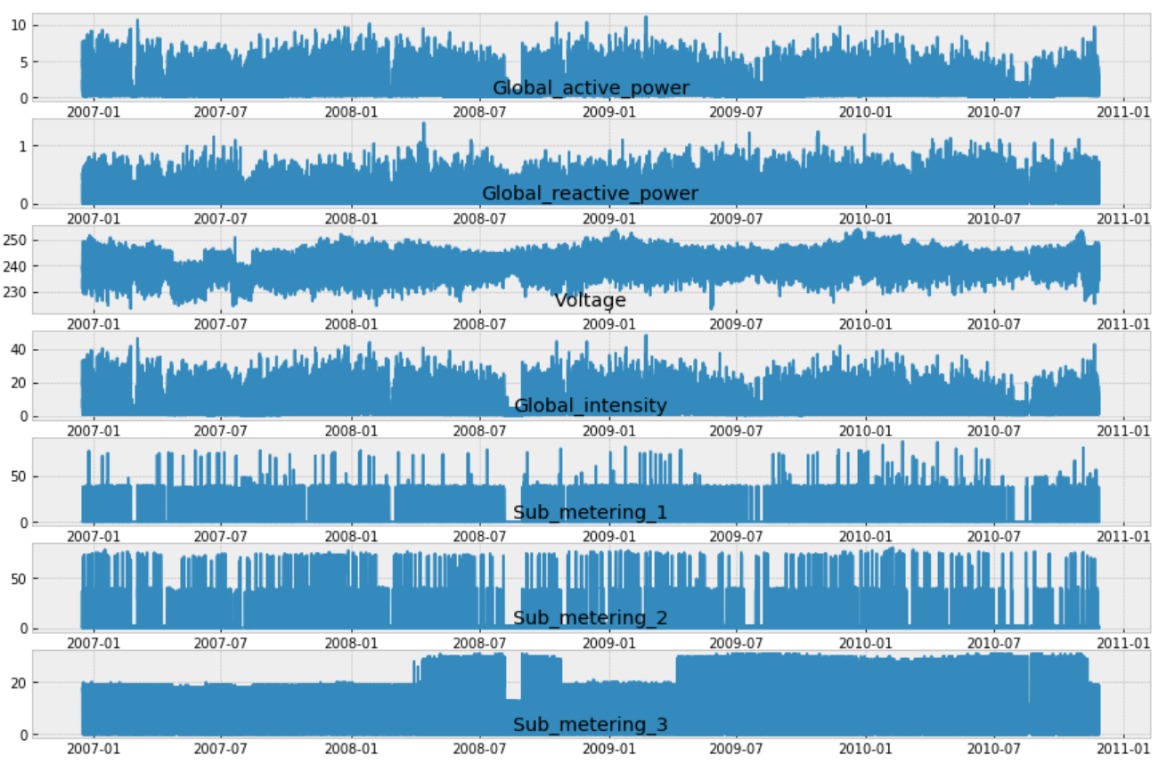
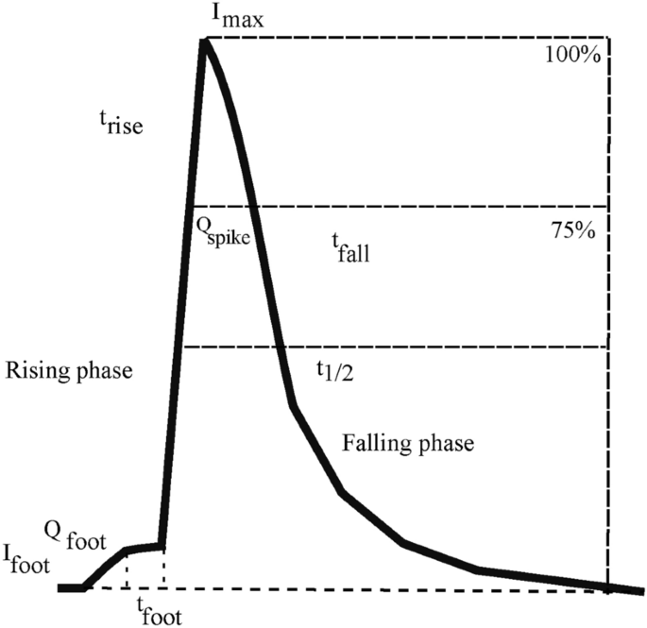
Exploratory Data Analysis(EDA)

Slide 10
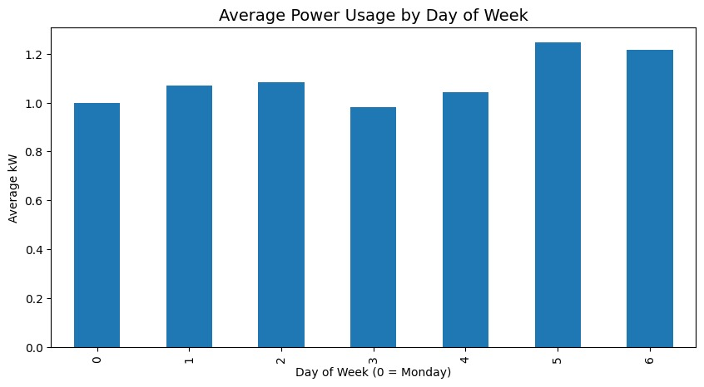
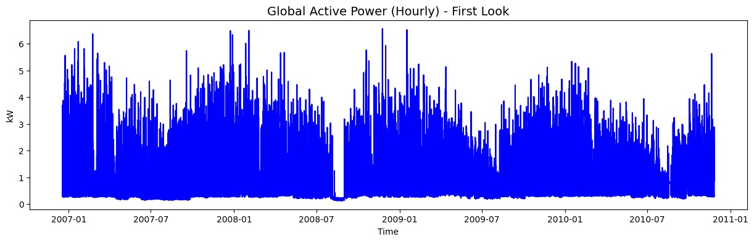
Key Observations
Electricity consumption varies significantly over time.
Several high spikes in energy usage are visible.
The distribution of power consumption is right-skewed, meaning most values are low with occasional high usage.
Maximum power consumption reaches around 6 kW.

Slide 11
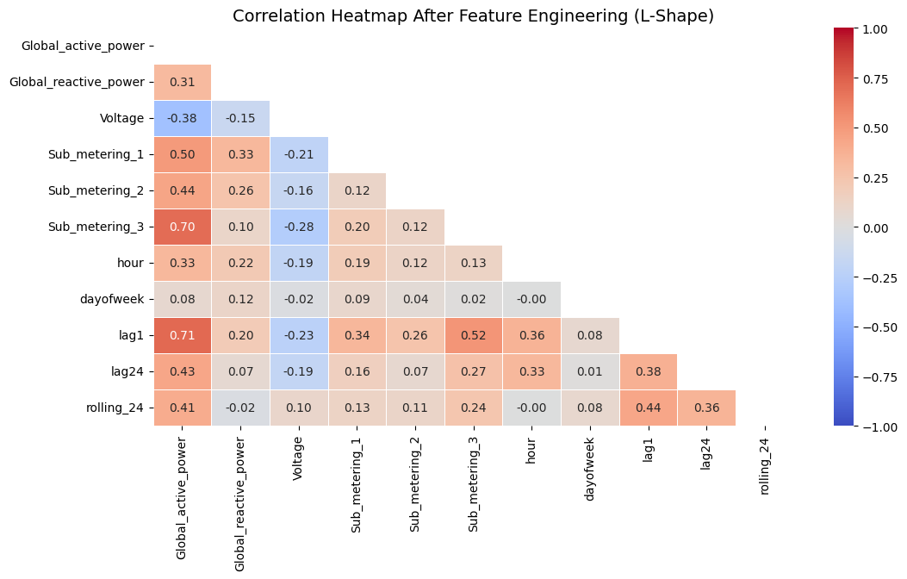
Correlation heatmap

Slide 12
Pre-processing
Handling Missing Values
Missing values were identified and removed to improve data quality.
Data Type Conversion
Numerical variables were converted into appropriate numeric formats for analysis.
Time Index Creation
Date and Time fields were combined to create a datetime index for time-series modelling.
Resampling
Original data was recorded at one-minute intervals.
Data was resampled to hourly intervals to reduce noise and improve computational efficiency.
Feature Engineering
Temporal features: Hour of Day, Day of Week.
Lag features: Previous consumption values (Lag1, Lag24).
Rolling statistics: 24-hour rolling mean.
Global Intensity was excluded from the forecasting models due to its near-perfect correlation with Global Active Power.

Slide 13
Models Used
RandomForest
RandomForest is an ensemble machine learning algorithm based on decision trees.
It builds multiple decision trees and combines their predictions to improve accuracy.
It reduces overfitting and improves model stability.
Used for: predicting electricity consumption using historical features.
XGBoost
XGBoost is a gradient boosting algorithm that builds trees sequentially.
Each new tree learns from the errors of previous trees.
It is known for high prediction accuracy and efficiency.
Used for: improving prediction performance for time-series data.

Slide 14
Models Used
Prophet
Prophet is a time-series forecasting model developed by Facebook.
It models trend, seasonality, and holiday effects in time-series data.
It is particularly useful for data with strong seasonal patterns.
Used for: forecasting electricity consumption trends.

Slide 15
Model result
Evaluation Metrics
The forecasting models were evaluated using the following metrics:
RMSE (Root Mean Square Error) – measures the prediction error magnitude.
MAE (Mean Absolute Error) – measures the average difference between predicted and actual values.
Model | RMSE | MAE
Random Forest | 0.2458 | 0.1606
XGBoost | 0.2433 | 0.1578
Prophet | 0.6285 | 0.4791

Slide 16
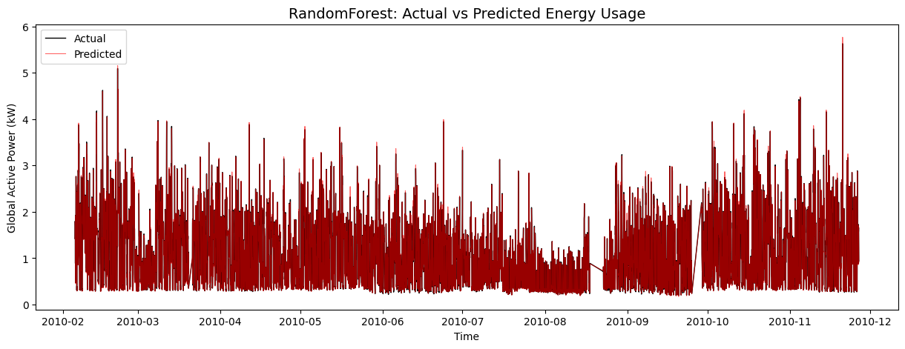
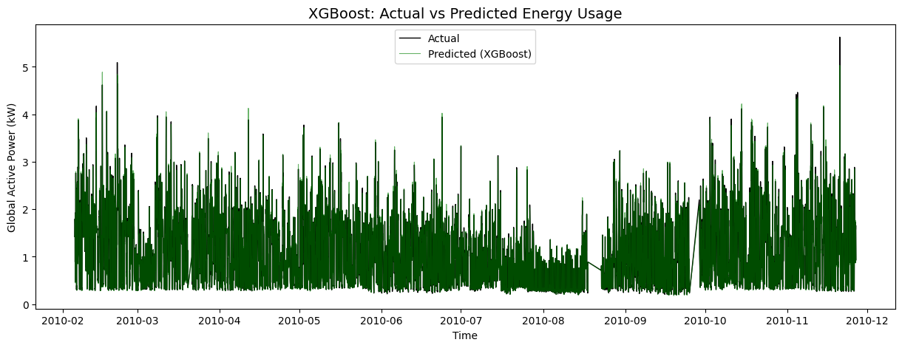
Overview
RandomForest achieved the best performance.
XGBoost also performed well.
Prophet captured seasonal trends but produced higher error.

Slide 17
Analysis
Are the Results Satisfactory?
• All forecasting models successfully captured the overall electricity consumption patterns.
• XGBoost achieved the best forecasting performance (RMSE = 0.2433, MAE = 0.1578).
• Random Forest produced very similar results (RMSE = 0.2458, MAE = 0.1606).
• Prediction plots show that the machine learning models closely follow actual consumption trends.
Is the Performance Good for This Task?
• Forecasting performance was evaluated using RMSE and MAE.
• The low error values obtained by XGBoost and Random Forest indicate strong predictive capability.
• Prophet effectively modelled trend and seasonality but produced higher forecasting errors.
Limitations
• Sudden consumption spikes remain challenging to predict accurately.
• Hyperparameter tuning was only applied to the Random Forest model.
• External factors such as weather and occupancy data were not included.
Future Improvements
• Extend hyperparameter tuning to all forecasting models.
• Investigate deep learning approaches such as LSTM, GRU, and Transformer models.
• Incorporate external variables such as weather conditions and occupancy information.
• Evaluate the framework using larger and more diverse energy datasets.

Slide 18
Summary and conclusions
Project Summary
• Developed a framework for household electricity consumption forecasting and anomaly detection using time-series machine learning models.
• Implemented and evaluated Random Forest, XGBoost, and Prophet using hourly household energy consumption data.
• Applied feature engineering techniques including temporal, lag, and rolling-window features to improve forecasting performance.
• Evaluated model performance using RMSE and MAE metrics.
Key Results
• XGBoost achieved the best forecasting performance (RMSE = 0.2433, MAE = 0.1578).
• Random Forest produced comparable results (RMSE = 0.2458, MAE = 0.1606).
• Prophet effectively modelled trend and seasonality but produced higher forecasting errors.
• Rolling Z-Score, Isolation Forest, and Prophet Residual Analysis successfully detected abnormal consumption patterns.
• Forecasting models provided the baseline required for effective anomaly detection.
Future Work
• Extend hyperparameter tuning to all forecasting models.
• Investigate deep learning approaches such as LSTM, GRU, and Transformer-based models.
• Incorporate external variables such as weather and occupancy information.
• Evaluate the framework using larger and more diverse energy datasets.

Slide 19
References
Adhikari, R. & Agrawal, R., 2013. “An Introductory Study on Time Series Modeling and Forecasting.”
Ahmed, H.A. & Khamees, M., 2025. “Forecasting Energy Consumption Using Time Series Models: A Comparison of Naïve, ARIMA, and Auto-ARIMA Approaches.” Proceedings of the International Conference on Applied Innovations in IT.
Cascone, L., Sadiq, S., Ullah, S., Mirjalili, S., Siddiqui, H.U.R. & Umer, M., 2023. “Predicting Household Electric Power Consumption Using Multi-step Time Series with Convolutional LSTM.” Big Data Research.
Syed, D., Abu-Rub, H., Ghrayeb, A. & Refaat, S., 2021. “Household-Level Energy Forecasting in Smart Buildings Using a Novel Hybrid Deep Learning Model.” IEEE Access.

